Slide 1

Development
Lessons of the 1990s
Presented by: Hosein Joshaghani, TeIAS
August 2020
Lawrence H. Summers - Former VP of development economics and chief economist of the WB (1991–93)
Pedro Malan - Former minister of finance of Brazil
Michael Mussa - Former Chief Economist at IMF (1991-2001)

Slide 2
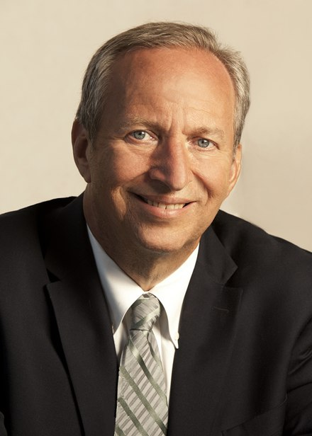
Larry Summers
Nephew of two Nobel laureates in economics: Paul Samuelson (brother of Robert Summers) and Kenneth Arrow (brother of Anita Summers).
former Vice President of Development Economics and Chief Economist of the World Bank (1991–93)
senior U.S. Treasury Department official throughout President Clinton's administration (ultimately Treasury Secretary, 1999–2001)
former director of the National Economic Council for President Obama (2009–2010)
former president of Harvard University (2001–2006)
director of the Mossavar-Rahmani Center for Business and Government at Harvard's KSG

Slide 3

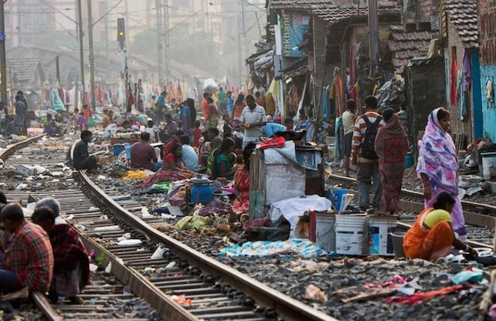

First visit to India - 1991
“Larry, if everything worked the way it did in Boston, it wouldn’t be a developing country—and we wouldn’t be here.
“Larry, in every sector in every developing country, it is easy to think of reasons why things are unsatisfactory, and why not all aid will be used effectively.
But the challenge is not to figure out reasons to not be constructive.
The challenge is to figure out ways to be constructive—and to make a big difference.”

Slide 4
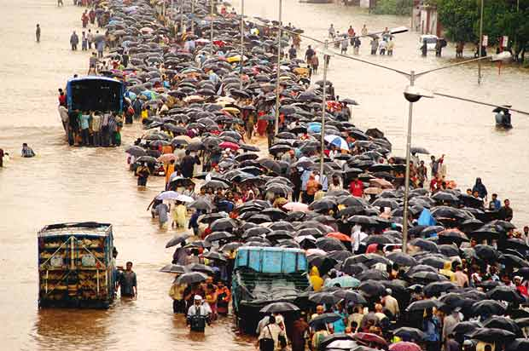
Five Lessons
The Importance of Institutional Capacity
Managing Crises and Capital Markets
Facing Uncertainties and Questions
Recognizing the Fungibility of Aid
Building a Constituency for Development

Slide 5
1) The Importance of Institutional Capacity
Well-executed policies + slightly misguided >> absolutely correct + poorly executed ones
institutional capacity to perform functions taken for granted in advanced market economies.
E.g. custody arrangement
collect on a bounced check, eviction of tenants who do not pay their rent, etc.

Slide 6
1) The Importance of Institutional Capacity
Acquiring the ability to do things in effective, directed, coherent ways is central to successful development.
It is extremely difficult to figure out ways to build that capacity.
I wish I had solutions to this challenge.

Slide 7
2) Managing Crises and Capital Markets

Slide 8
3) Facing Uncertainties and Questions
It is impossible to predict economic and other developments, and that countries should be careful what they wish for.
Emerging market economies build up reserves to reduce the risks of future crises.
Today: Global saving gluts
And those loans, with a 1 percent interest rate ex ante, have a negative effective rate when likely currency movements are taken into account.

Slide 9
4) Recognizing the Fungibility of Aid
When it came to truly important projects, developing country governments would pursue them with or without Bank support.
At the IMF it is standard doctrine that sterilized intervention does not work, and that IMF funds should not be used for direct budget support.
Yet the IMF still engages in sterilized intervention.

Slide 10
5) Building a Constituency for Development
There is a profound need in the United States to build a constituency for development and for meeting the needs of the world’s poorest people.
But the problem of the 1 billion people living on less than $1 a day does not evoke their passionate interest in the same way as environmental issues.
Again, though, my final observation from the 1990s is the need to strengthen political support in rich countries for development efforts in poor ones.

Slide 11
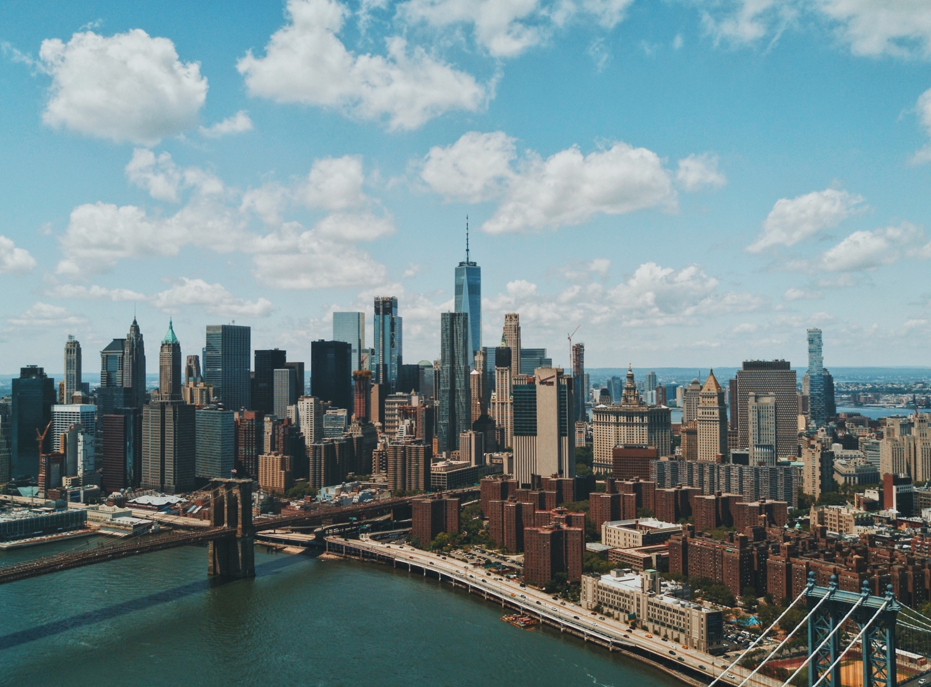
Discussion

Slide 12
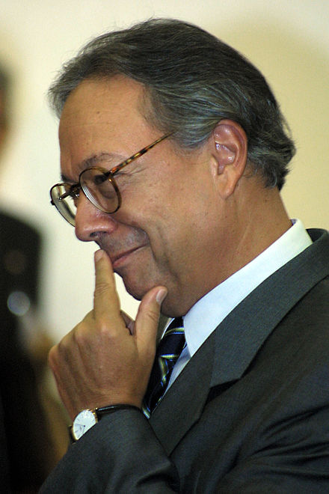
Pedro Malan
a Brazilian economist.
Former president of the Brazilian Central Bank, from September 9, 1993 to December 31, 1994.
Former Minister of Finance of Brazil, January 1, 1995 to December 31, 2002.
Official negotiator of the foreign debt of Brazil with the International Monetary Fund.
He is credited with successfully reforming the nation's banking system, saving Brazil from the negative effects of 1997's Asian market crisis.
He was also one of the architects of the Plano Real.

Slide 13
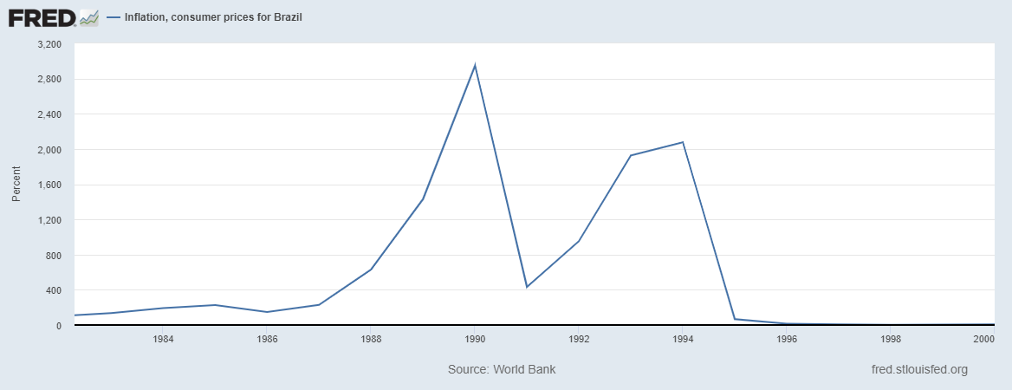
Brazil Inflation: During 1990s

Slide 14
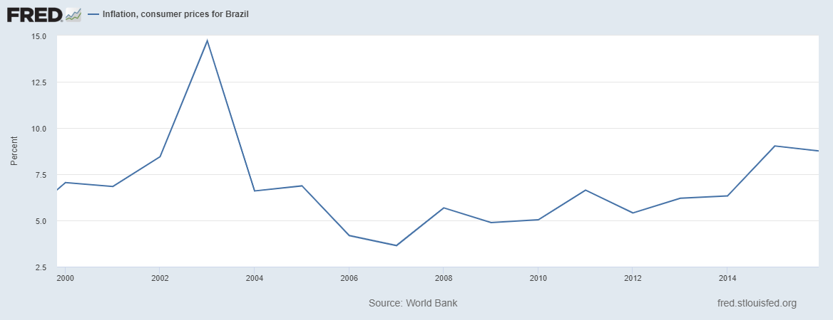
Brazil Inflation: after 2000

Slide 15
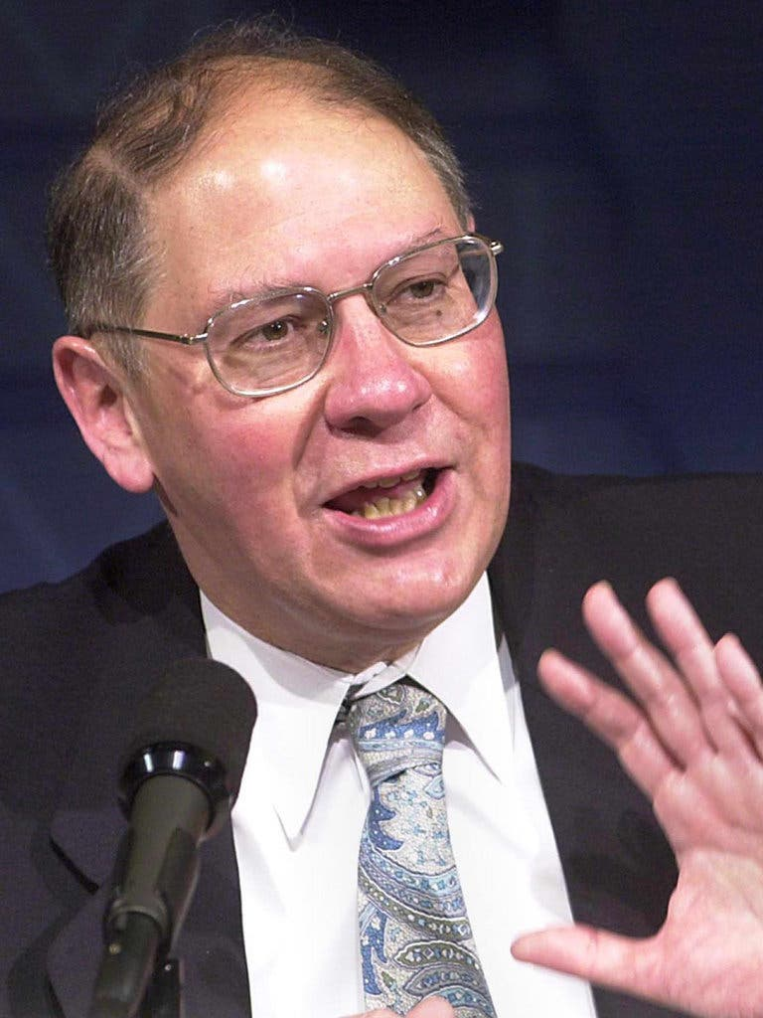
Michael Mussa
Michael Louis Mussa (April 15, 1944 – January 15, 2012) was an American economist.
He was chief economist at the International Monetary Fund from 1991 to 2001.
A member of the Council of Economic Advisers from 1986 to 1988.
He was also a Senior Fellow at the Peterson Institute for International Economics from 2001 until his death in 2012.

Slide 16

Thank you !

